Slide 1
NEW TECHNOLOGIES IN THE TREATMENT OF CHRONIC PAIN
Ma Luo, MD
Ellen Lin, MD
Interventional Pain Management
Advanced Spine and Pain Center

Slide 2
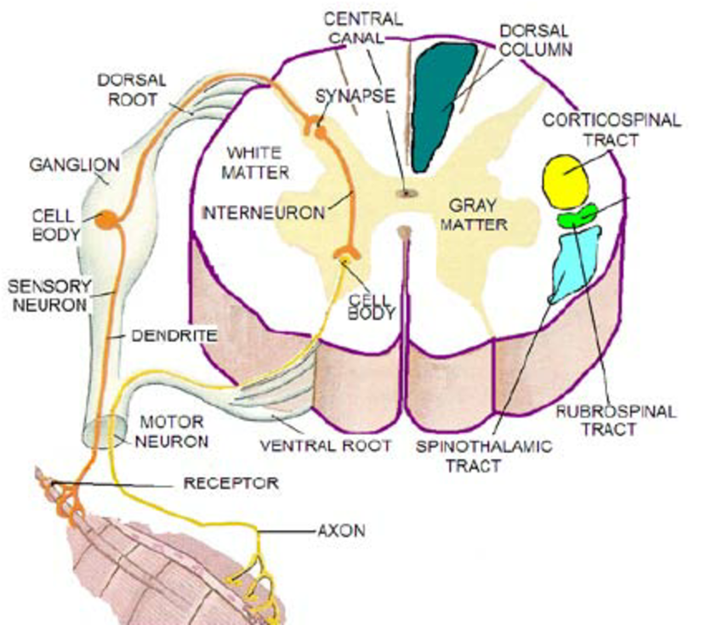
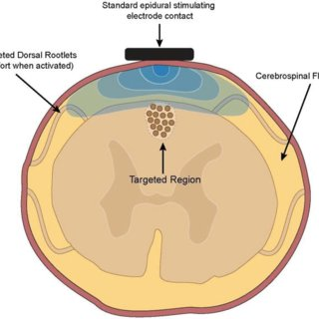
SPINAL CORD STIMULATOR
Using electrical leads to block/modulate the pain at the spinal cord level

Slide 3
CURRENT INDICATIONS
Complex regional pain syndrome
Lumbar post-laminectomy Syndrome (Fail back syndrome)
(New Indication) Non Surgical Refractory Back Pain
(New Indication) Painful diabetic neuropathy

Slide 4
SPINAL CORD STIMULATION TRIAL
7 day trial

Slide 5
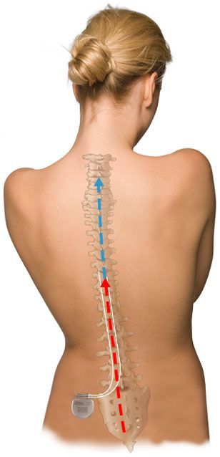
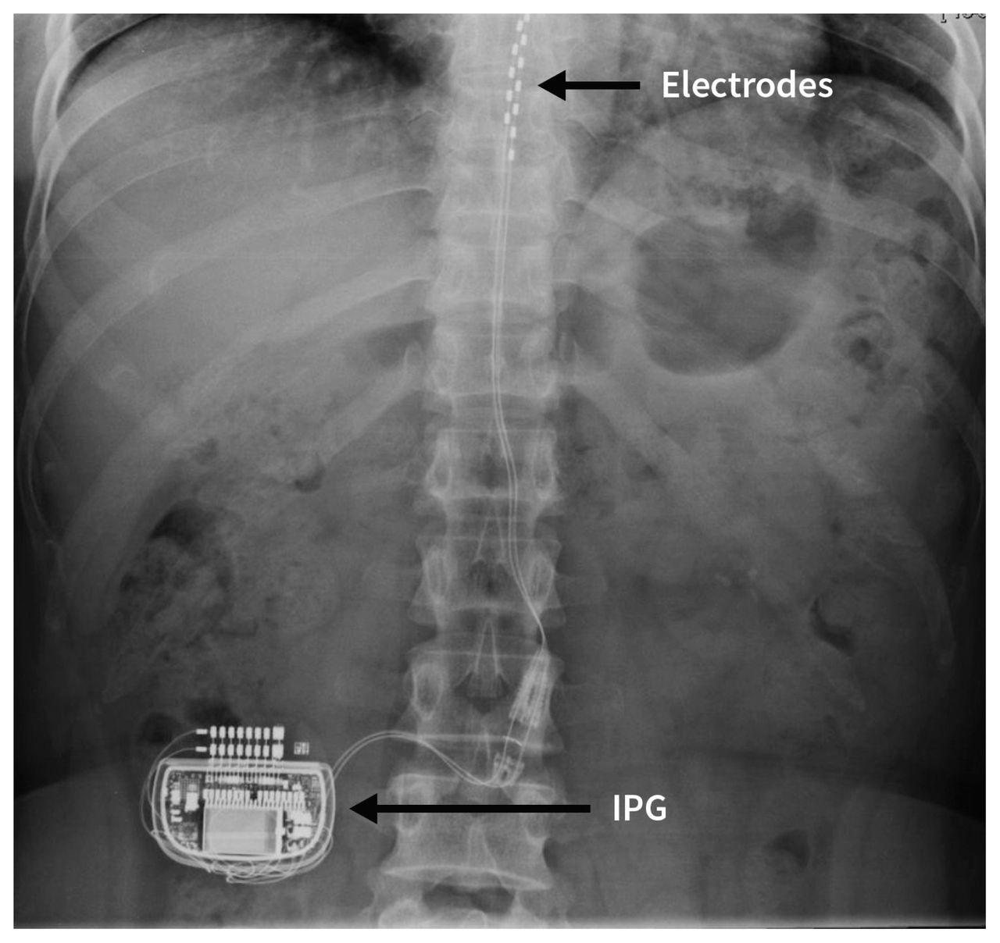
SPINAL CORD STIMULATOR
Implantation of battery as well as leads only if the trial if helpful

Slide 6
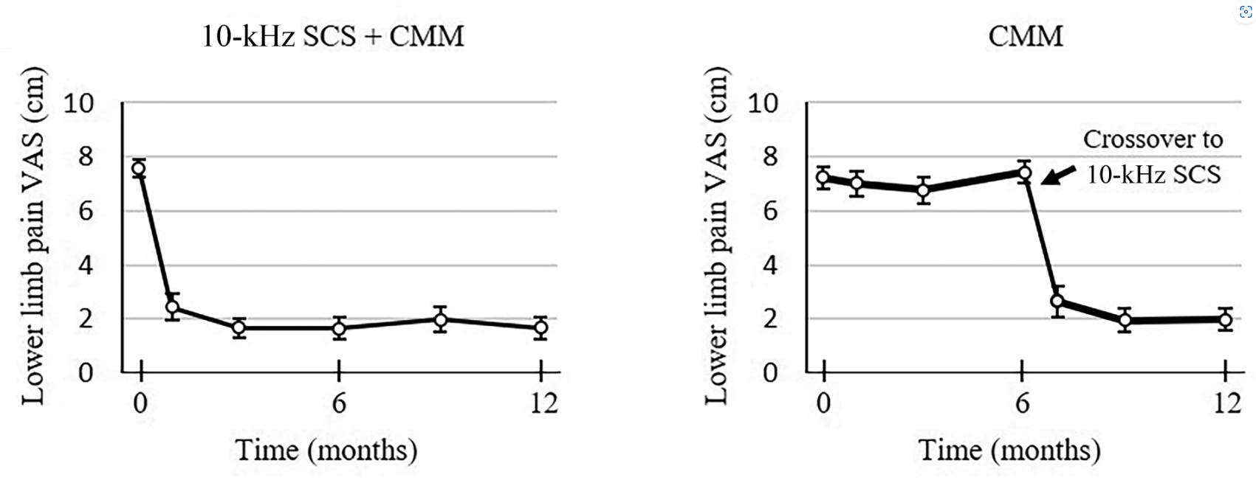
SCS ON PAINFUL DIABETIC NEUROPATHY
Notes:
103 in medication group vs. 113 in spinal cord stimulation with medication.

Slide 7
SCS ON NON SURGICAL BACK PAIN
Notes:
Non fail back surgery 12 from senza RCT with 15 from senza EU combined, back is blue and green is legs

Slide 8
DORSAL ROOT GANGLION STIMULATION
Using electrical leads to block/modulate the nerves at the spinal cord level
Treatment for Complex Regional Pain Syndrome
Specifically Causalgia Type II
Minor injury to a nerve with significant pain in that nerve or around the nerve distribution

Slide 9
COMMON CONDITION DRG CAN HELP
Persistent Foot pain after ankle injury or surgery
Hip pain after hip replacement
Knee pain after knee replacement
Testicular pain after vasectomy
Groin pain after hernia surgery
Small focal area is the key

Slide 10
DORSAL ROOT GANGLION STIMULATION

Slide 11
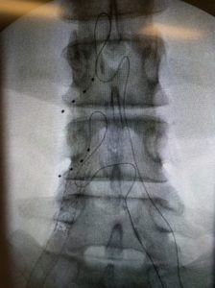
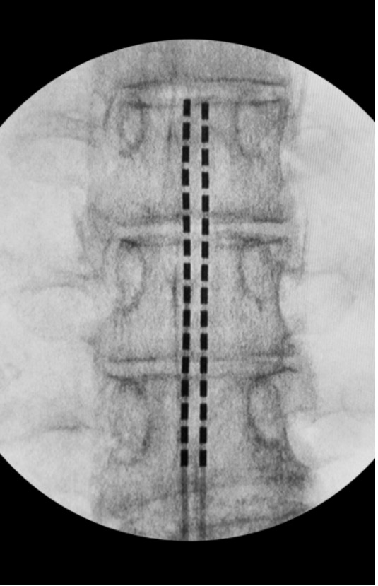
DRG SCS

Slide 12
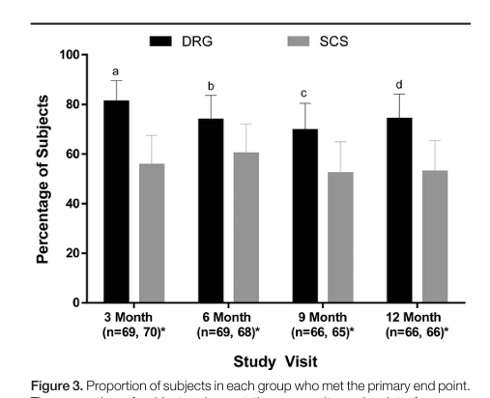
Notes:
76 in DRG vs. 76 in SCS percentage of people who got 50% pain relief at 12 month.

Slide 13
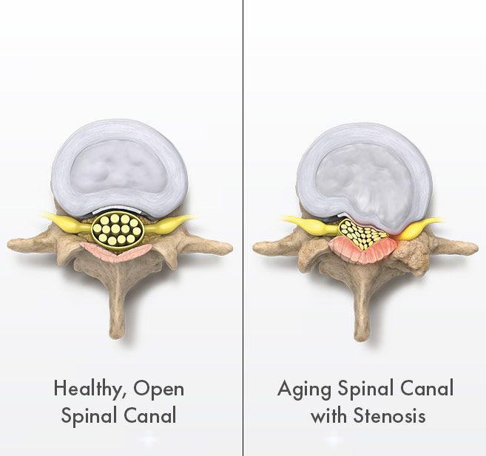
MILD PROCEDURE FOR LUMBAR STENOSIS
Treatment for lumbar stenosis
Pain, numbness and tingling in back, legs and buttock when standing or walking
Improves with sitting or hunched over
Shopping Car Sign
Rocking Chair Sign

Slide 14
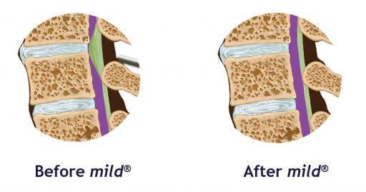
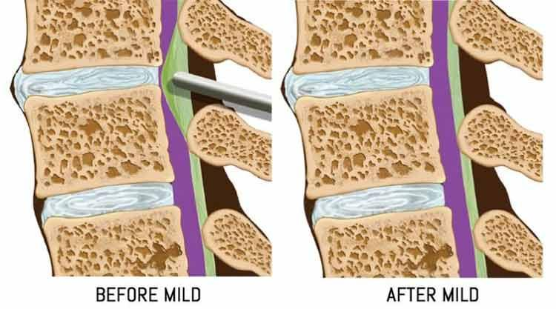
MILD PROCEDURE FOR LUMBAR STENOSIS
Notes:
https://www.youtube.com/watch?v=f3diNgQj9sQ

Slide 15
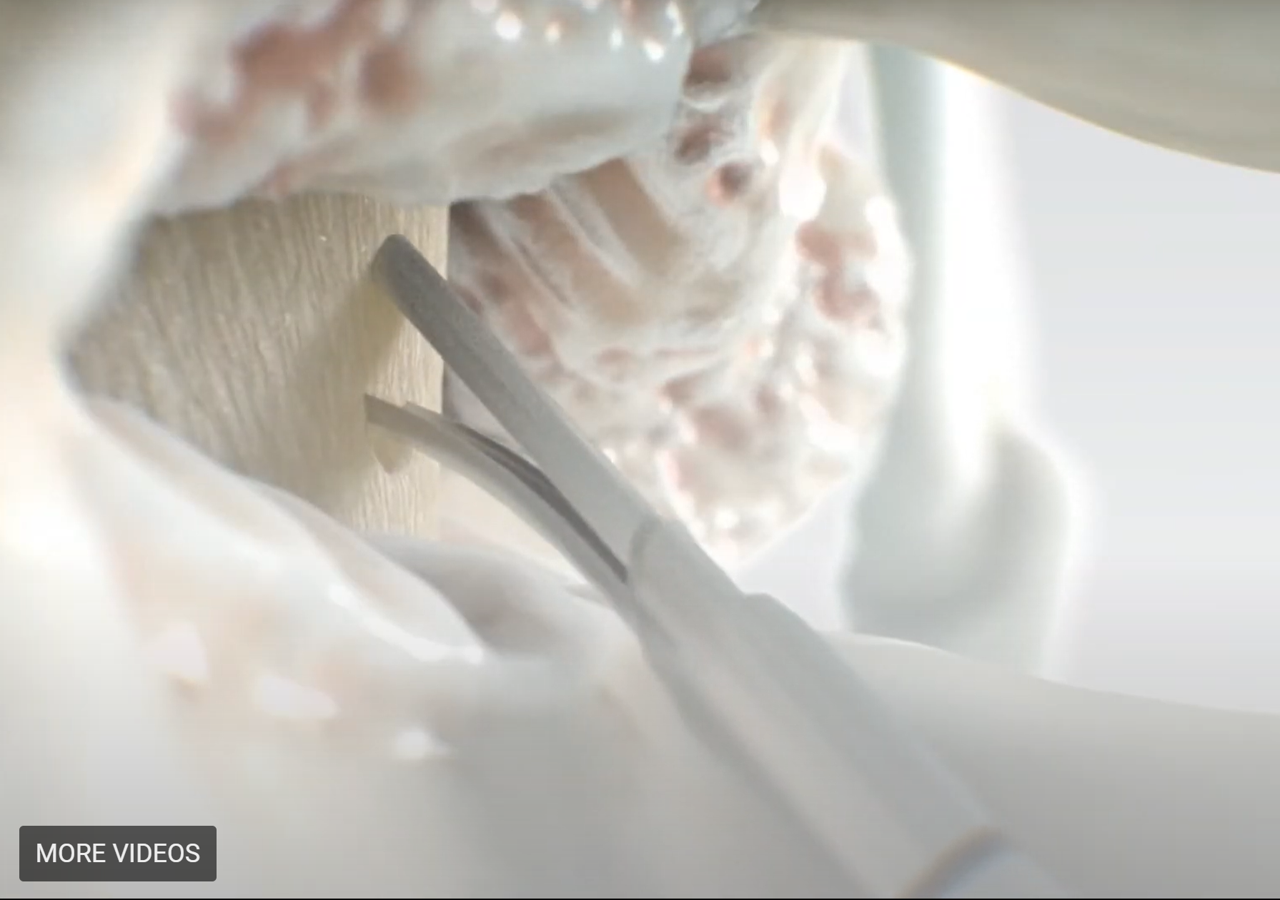
MILD PROCEDURE

Slide 16
POST PROCEDURE CARE FOR MILD
No incisions
Resume normal activity after 24 hours
Walk about 20 minutes twice a day with one day rest in a week.

Slide 17
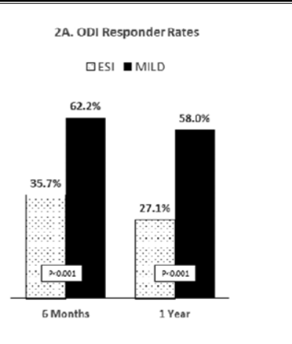
MILD STUDY
Notes:
149 in MILD procedure vs 153 to the interlaminar ESI group up to 4 a year, primary end point % of responder 10 point on ODI.

Slide 18
INTRACEPT PROCEDURE FOR BACK PAIN (VERTEBRALGENIC)
Treatment for disc related pain
Pain worse with sitting/standing in the same position
Pain worse with leaning forward to tie shoes/pick up things
Pain improves with shifting weight/lean

Slide 19
INTRACEPT PROCEDURE FOR BACK PAIN (VERTEBRALGENIC)

Slide 20
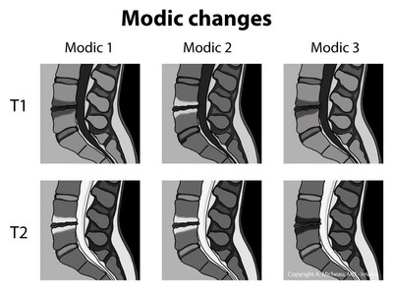
INTRACEPT PROCEDURE FOR BACK PAIN (VERTEBRALGENIC)

Slide 21
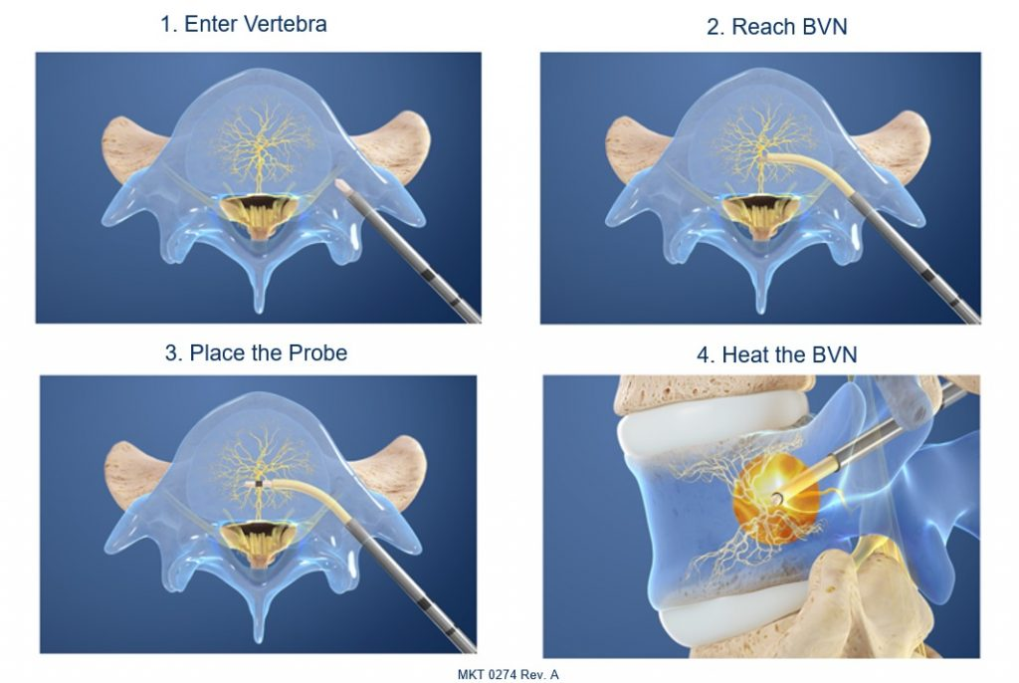
INTRACEPT PROCEDURE FOR BACK PAIN (VERTEBRALGENIC)

Slide 22
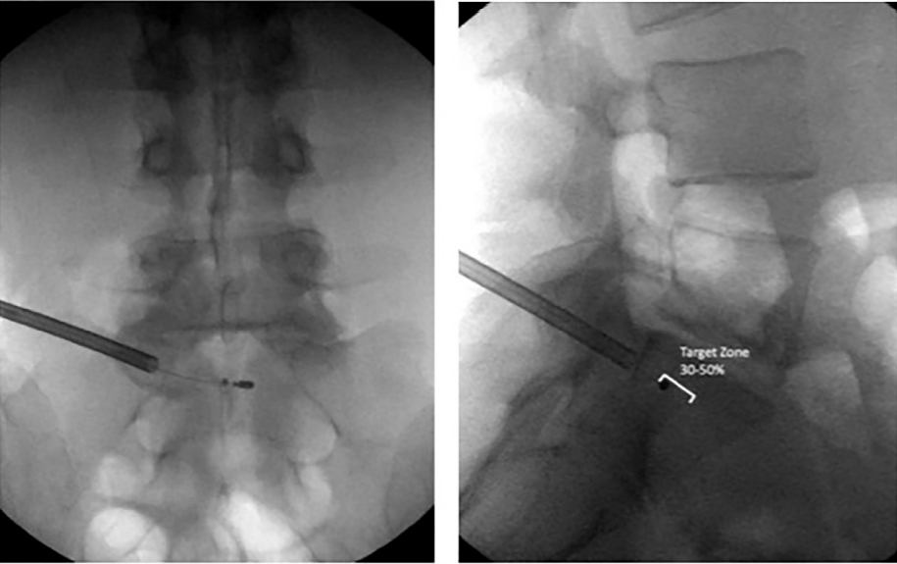
INTRACEPT PROCEDURE FOR BACK PAIN (VERTEBRALGENIC)

Slide 23
POST PROCEDURE FOR INTRACEPT
-No incisions
-Light activity for 3-5 days
-Walk the same day
-Resume normal activity after 5 days

Slide 24
INTRACEPT STUDY
Notes:
147 intracept vs. 78 control arm, 100 people at 5 year follow up.

Slide 25
PERIPHERAL NERVE STIMULATION
Small electrical leads to stimulate and block pain
Ability to target individual nerves
Common Areas: Shoulder/Leg/ Hip/Knee/Foot/Ankle
7 Day of trial-minimally invasive

Slide 26
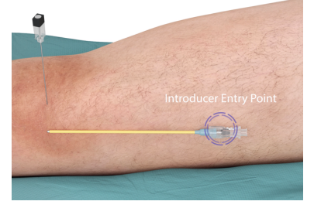
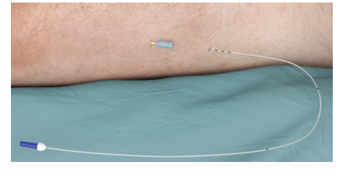
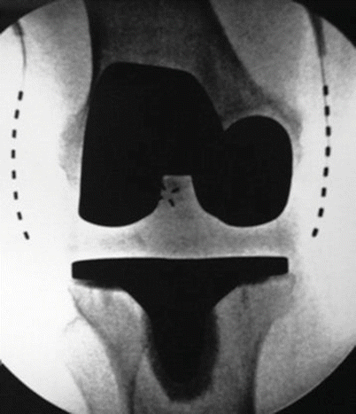
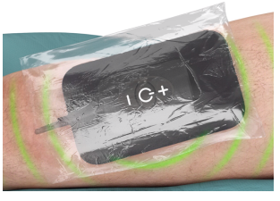
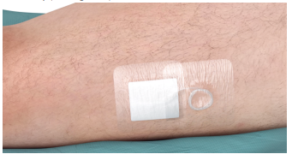
KNEE TRIAL PERIPHERAL NERVE STIMULATION

Slide 27
PERIPHERAL NERVE STIMULATION
Implant involves the placement of electrical leads under the skin
Battery will be external

Slide 28
TENJET
Treatment for Tendinosis or Chronic Tendonitis
High velocity jet of “water” saline to resect diseased tendon
Tennis Elbow, Side of the hip(bursa), rotator cuff/Shoulder, Knee, Hamstring, Achilles and Plantar fasciitis

Slide 29
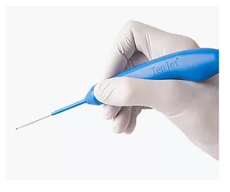
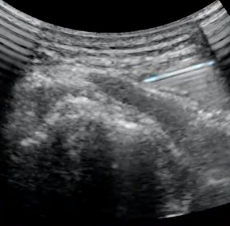
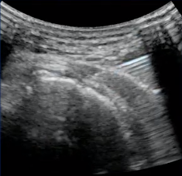
TENJET
Gluteal Tendon Before After

Slide 30
TENJET POST PROCEDURE CARE
Ok to resume regular activity the day after
No heavy load on the tendon until 2 week after

Slide 31
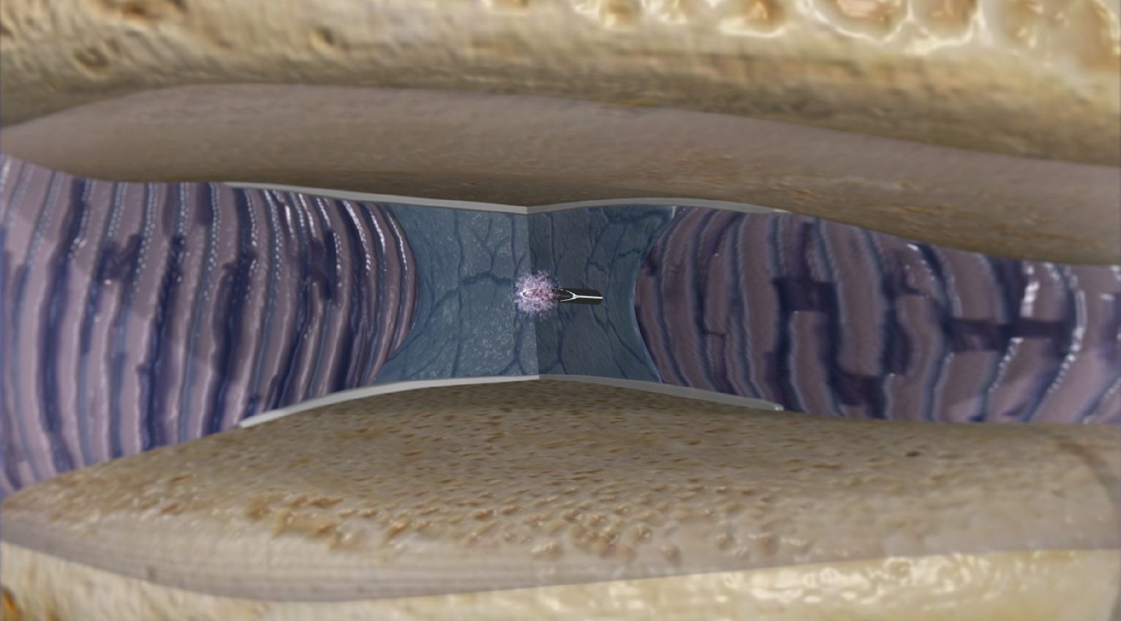
VIA DISC NP (Nucleus Pulposus) FOR DISCOGENIC LOW BACK PAIN
Age-related wear and tear of the intervertebral disc can cause loss of hydration
and degeneration
VIA Disc NP is delivered into the degenerated disc through a 20G spine needle
After delivery, VIA Disc NP supplements the degenerated intervertebral disc

Slide 32
VIA DISC NP (Nucleus Pulposus) FOR DISCOGENIC LOW BACK PAIN
For patients with lower back pain related to disc degeneration
Lower back pain is midline with or without radicular symptoms
Worsen with heavy load on the spine, leaning forward, and sitting intolerance

Slide 33
VIA DISC NP
Notes:
218 pt triple arm RCT, no modic changes up to type 2 modic changes, minimum of 6 months conservative care. Data currently gathered out to 3 years and submitted for publication, showing safety and long term efficacy of therapy

Slide 34
POST PROCEDURE INSTRUCTIONS FOR VIA DISC NP
-No incision
-Walk the same day
-Return to work as soon as you’re comfortable
-Resume normal activity after 5 days
-Do not submerge needle site in water for 1 week post procedure
-Avoid strenuous activities, and lifting more than 15 lbs. for up to 14 days post procedure

Slide 35
QUESTIONS?
Clinic number 210-690-0777
Texas Center for Athletes
21 Spurs Lane, Suite 240 San Antonio Texas 78240 USA
Westover Hills
10010 Rogers Crossing, Suite 230 San Antonio, TEXAS 78251
Stone Oak
255 E. Sonterra Blvd, Suite 203 San Antonio Texas 78258

