Slide 1
Nutrition as A Tool to Assist with Pain Management
Barbra Swanson ND, RDN,LD
210-414-5217

Slide 2
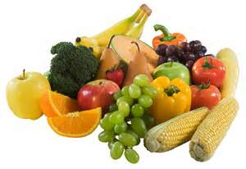
How Foods Inflict Pain
Inflammation: a normal immune response to protect the body against injury and infection. Ex: Bug bite = swelling, itchiness
Some conditions cause the immune system to set off inflammatory response even when there is no foreign organism to protect against (i.e. autoimmune diseases)
Certain types of pro-inflammatory proteins also work directly by activating nerve cells that can both initiate and intensify pain.
How does food play into this?
About 70% of your immune cells and found in the digestive tract (GI tract). Diet can have a powerful effect when it comes to mediating the inflammatory response. Certain foods have been shown to ease inflammation while others can set off symptoms and make inflammation worse = PAIN.
Taking control of your diet can be an easy and effective way to reduce inflammation and relieve pain

Slide 3
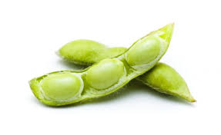
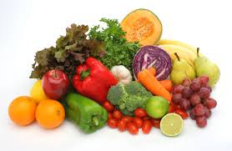
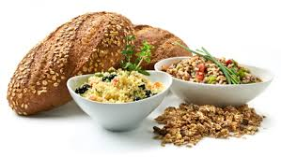
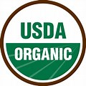
Pain – Triggering Foods
Dairy - ~ 75% of the world loses the ability to digest lactose at some point. One study showed that eliminating dairy in arthritis reduced inflammation and painful symptoms. Switching to a plant-based, lower fat diet significantly decreased symptom severity an inflammation in patients with RA.
Soy – Unfermented soy contains phytic acid, an anti-nutrient that impairs nutrient absorption and irritates gut lining increased gut permeability (leaky gut), a condition that allows particles to pass from the intestines into the blood. This can contribute to inflammation and may also cause symptoms like joint pain, nutritional deficiencies, skin rashes and mood changes.
Nightshade vegetables – plants from the Solanaceae family including tomatoes, chili and bell peppers, potatoes, eggplants. Can trigger joint pain, muscle aches in sensitive persons. Elimination diet can be helpful to test for triggers foods.
Gluten – a protein in wheat, barley, rye. (Oats, if in a shared factory that processes wheat). Can be in salad dressings, deli meats. Animal and test tube studies suggest that gluten may increase inflammation and exacerbate leaky gut syndrome by activating a specific protein involved in intestinal permeability. AVOID PROCESSED FOODS !
AVOID GMO!

Slide 4
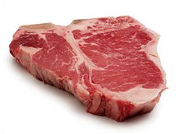
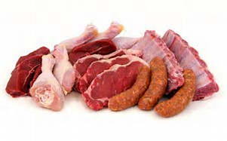
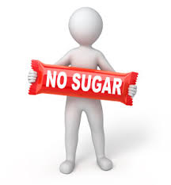
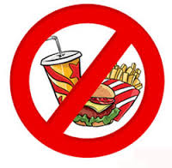
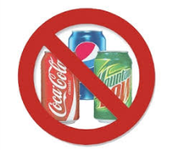
Pain – triggering Foods, cont’d
Alcohol – Overuse can weaken the liver (a detox organ), amp up inflammation, and worsen IBD. Avoid sugary mixers; < 5 drinks/week
Meat - consumption of red and processed meat is associated with inflammation and is believed to be a major cause of chronic pain.
Sugar – High sugar diet can cause alterations in gut microbiome, that can promote inflammation and negatively influence immunity. May increase intestinal permeability, allowing particles to pass through the bloodstream, triggering leaky gut symptoms, including pain.
Processed foods – “if it was made in a factory, don’t eat it”. 58% of Western Diet is ultra-processed foods. (S.A.D.) i.e. convenience foods, snacks cakes and bars, deli meats, sodas, juices, fast food, cereals, potato chips = higher levels of inflammatory markers/increased inflammation.
“Eat what God made, not what man-made.”
Vegetable Oils – Corn, safflower, cottonseed, soy oils are high in omega 6 EFA that are pro-inflammatory. Study associated a diet high in Omega 6 = more pain, inflammation, functional limitations, pain sensitivity, distress in pts w/ knee pain

Slide 5
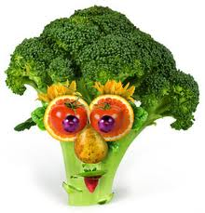
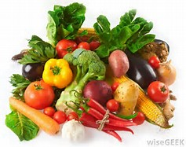
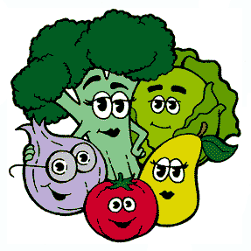
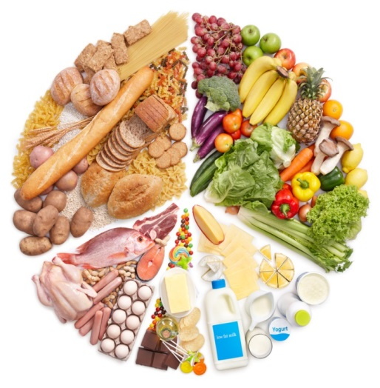
Top Anti-inflammatory Foods
Green Leafy Vegetables – spinach, Swiss chard. Contain anti-inflammatory flavonoids, antioxidants A and C, K
Bok Choy – contains over 70 antioxidant phenolic compounds that scavenge free radicals
Celery, celery seeds – lower inflammation and fight bacterial infections
Beet – repairs inflammatory cell damage and is potent anti-inflammatory; contains magnesium that is strongly liked to inflammatory conditions
Broccoli – high in potassium, magnesium, potent antioxidants, vitamins, flavonoids, carotenoids that act as anti-inflammatory substances
Blueberries – contains quercetin, strong anti-inflammatory that also fights cancer
Pineapple – contains bromelain, that has immune-modulating abilities (helps regulate the immune response to affect inflammation)
Salmon – excellent source of Omega 3 Essential fatty acids (EFA’s); show consistent relief of inflammation and reduction of need for anti-inflammatory medications. Do NOT buy farm raised fish!
Bone broth – contains chondroitin sulfates and glucosamine that reduce inflammation, arthritis and joint pain; helps heal leaky gut and damaged cell walls of inflamed gut

Slide 6
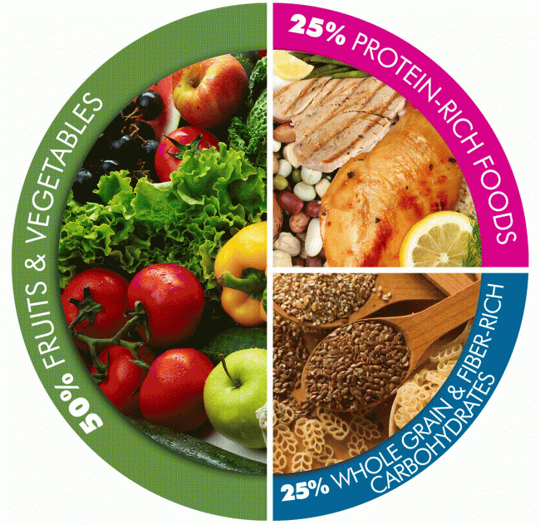
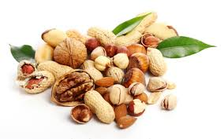
Top Anti-inflammatory Foods, cont’d
Walnuts – contain omega 3 EFA, phytonutrients protective against metabolic syndrome (an inflammatory disease), CVD, Type 2 DM
Coconut Oil – high levels of antioxidants effective against arthritis pain/inflammation; use topically or in cooking
Chia Seeds – antioxidant, anti-inflammatory, contain Omega 3 EFA, vitamins, minerals; ability to reverse inflammation, regulate cholesterol, reverse oxidative stress
Flaxseeds – excellent source of Omega 3 EFA, phytonutrients, antioxidants for cellular health; polyphenols support good gut bacteria and may help eliminate yeast and candida in the body; grind fresh before using
Turmeric – contains curcumin an active anti-inflammatory component, that is stronger than aspirin; effective in RA, reducing IL-6 (interleukin 6 cytokine inflammatory marker)
Ginger – an immune modulator; helps reduce inflammation caused by overactive immune response; may help treat inflammation in allergic and asthmatic disorders

Slide 7
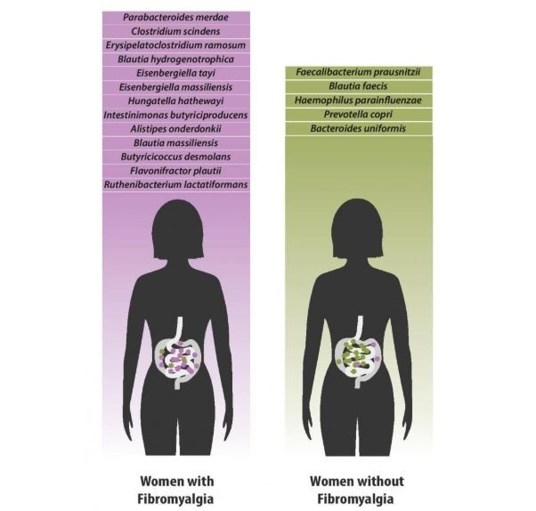

Slide 8
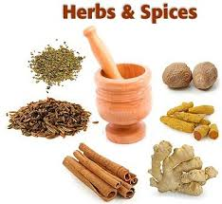
Natural Painkillers
Painfully Spicy Foods – wasabi, cayenne are natural painkillers
Cayenne - kills candida an infection linked to joint pain; alleviates post-operative pain, including post-surgical pain
Wasabi – isothiocyanates could block an inflammation receptor
Arnica Oil - safe for topical use eases inflammatory pain associated with arthritis
Peppermint Oil – painkiller, muscle relaxant; can alleviate fibromyalgia; improves circulation
Epsom Salt – natural painkiller for bone and joint pain and muscle soreness
Bone Broth – contains minerals in forms that body can easily absorb. Contains chondroitin sulfate and glucosamine that reduce inflammation, arthritis and joint pain.
Herbs – Clove, Cinnamon, Oregano, Turmeric, Cocoa, Cumin, Parsley, Basil, Ginger, Thyme, Garlic, Green tea….. Aim to consume 2 -3 servings of these herbs in essential oils or herbal teas daily
** Essential oils are POTENT and must be diluted in a carrier oil, so consult a knowledgeable practitioner before use **

Slide 9
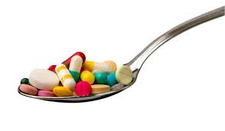
Antioxidant Supplements
Glutathione – body’s most important antioxidant; found within the cells and boosts activity of other antioxidants/vitamins; can prevent fat peroxidation to fight inflammation
Quercetin – 500 mg twice a day for 12 weeks may help inflammatory problems like chronic fatigue, arthritis
Lutein – Food sources safer than supplements; found in dark orange and red colored foods
Vitamin C – Necessary for collagen formation; improves immunity
Resveratrol – Found in cocoa, red grapes, dark berries; is an antioxidant produced by plants as a response to stress, injury and fungal infections.
Astaxanthin – Found in wild-caught salmon and krill; supports joint health
Selenium – found naturally in the soil but is becoming depleted; Brazil nuts, walnuts, whole grains, wild-caught fish
Lavender Essential Oil – reduces inflammation; produces important antioxidant enzymes

Slide 10
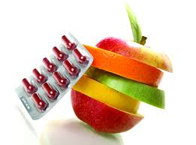
How to Identify and Heal
Test for food allergies, lactose intolerance and celiac disease
Elimination Diet: Cut out suspect food; reintroduce slowly over time
Eat abundant anti-inflammatory foods in the meantime
Use anti-inflammatory hers, teas and supplements to augment diet

Slide 11
Resources
www.PCRM.org (Physician’s Committee for Responsible Medicine
www.forksoverknives.com
www.drweil.com

