Slide 1
Story of a “PainHero”
Marianne Pinkston, MD
DRPBETTERLIFE.COM
GPA Board Member
Sept 24, 2022

Slide 2
Timeline
January 20, 2007 Rheumatoid Arthritis
2011- Renal Disease/ Failure, GI bleed
2011- Autoimmune Hepatitis
2013- 300lbs reached
2014 Diabetes
2017-18 Melanoma twice
LOST 162lbs one year and 2 months

Slide 3
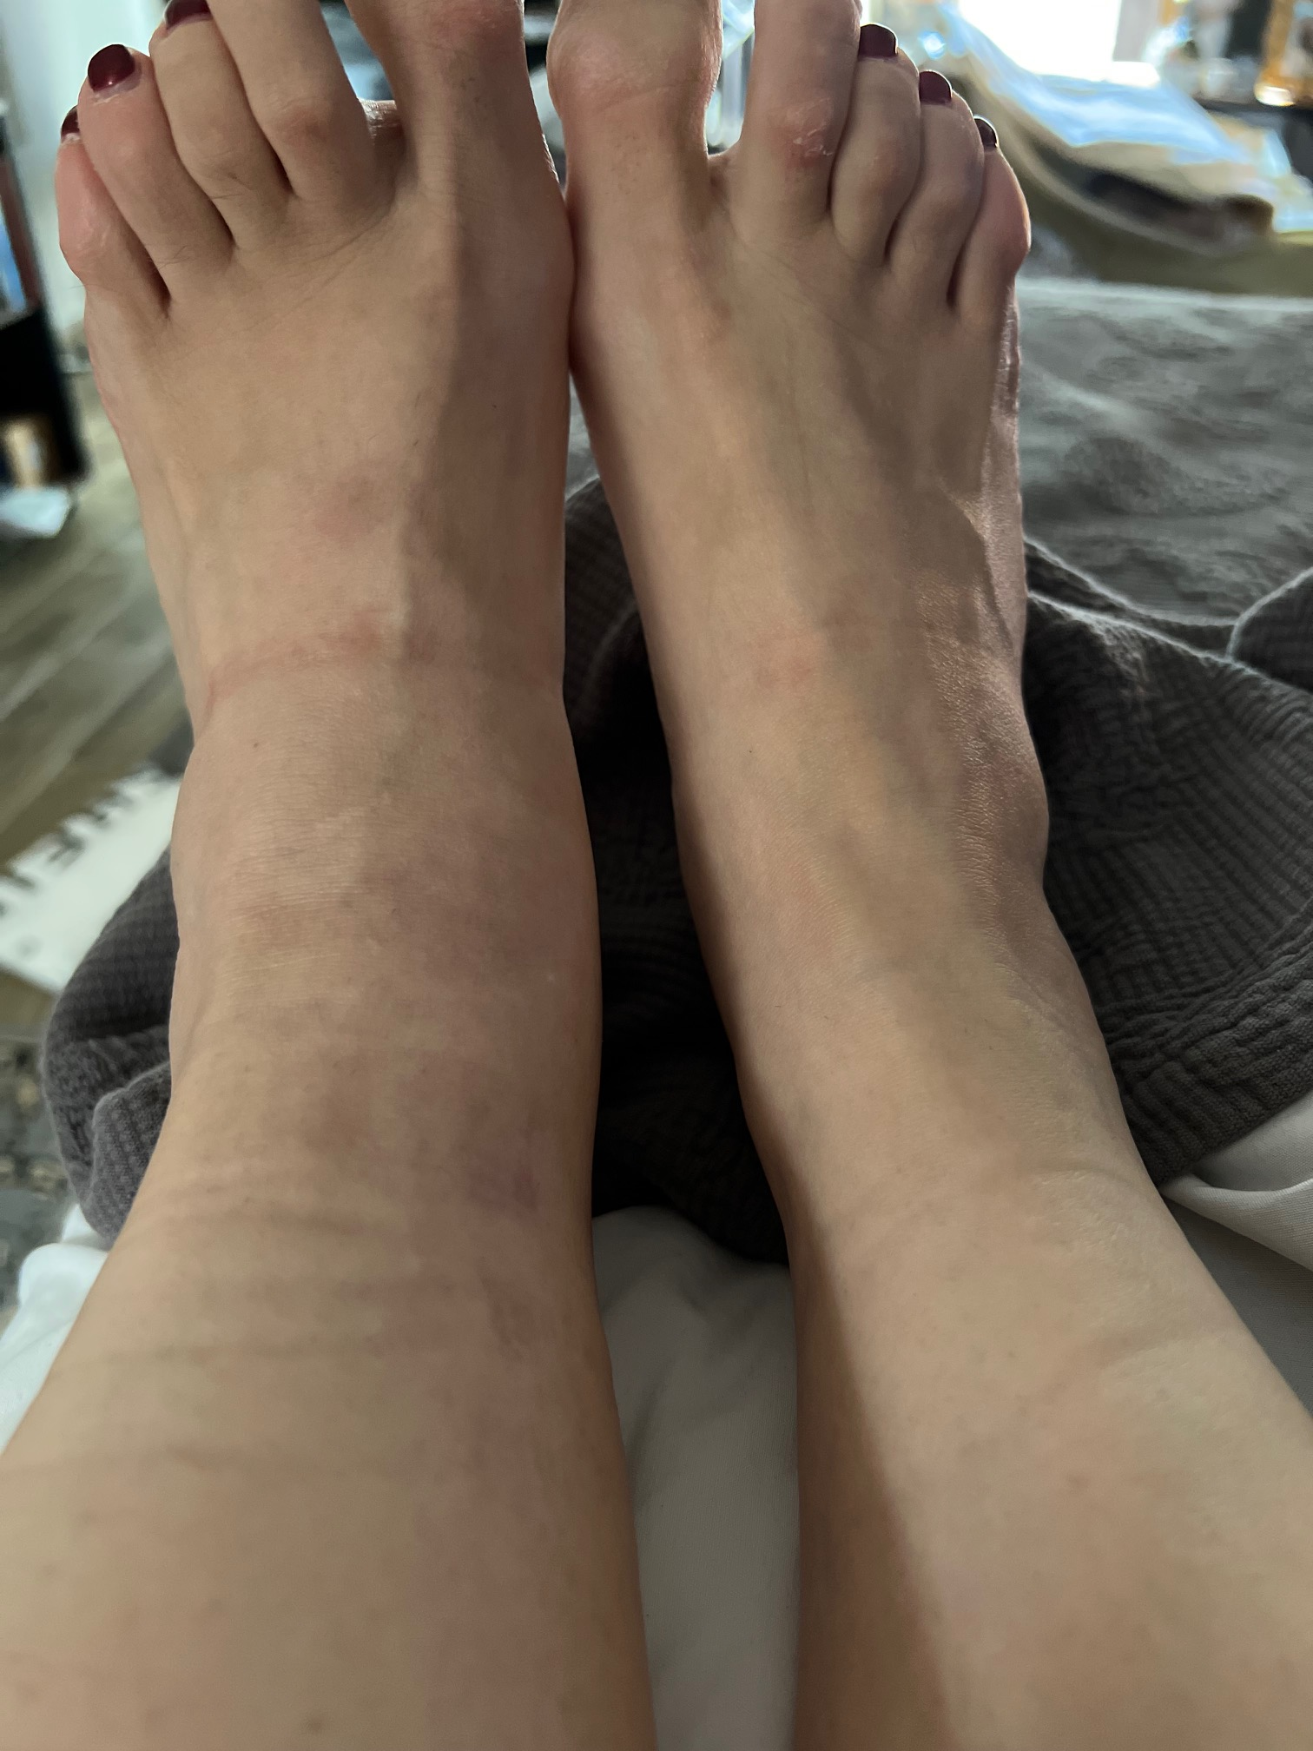
L
RA Damage

Slide 4
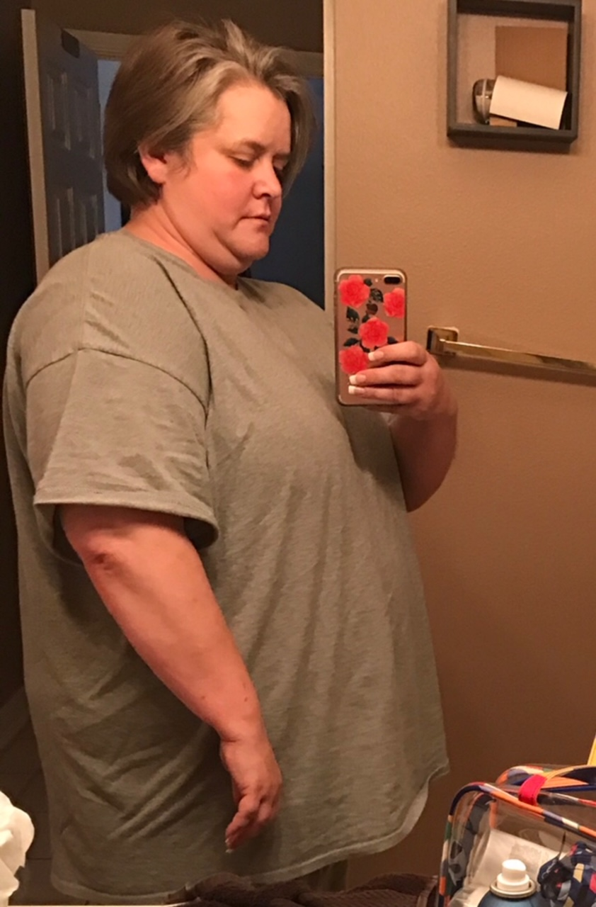
2 year

Slide 5
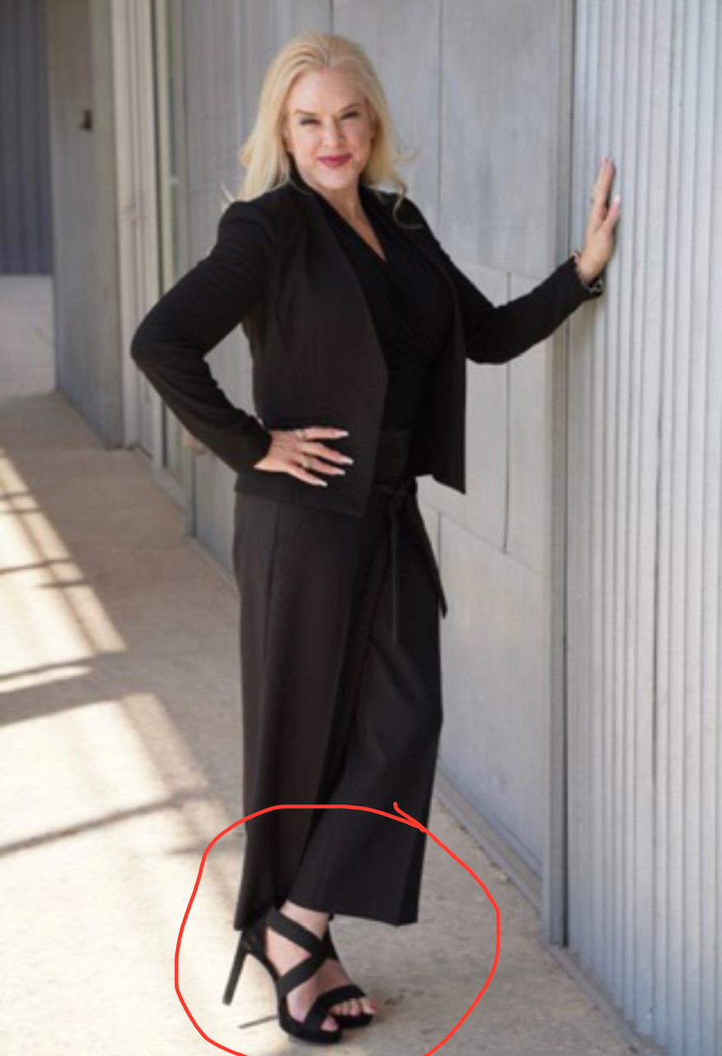
When to give up and when not to…
NEVER

Slide 6
This is not woe is me… This is WOW is me!!!
-Pinkstonism

Slide 7
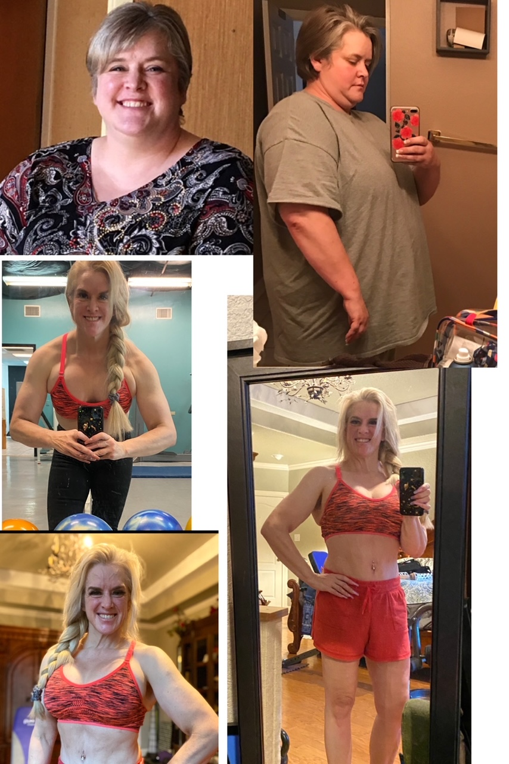
Thank you
Marianne Pinkston, MD
DRPBETTERLIFE.COM

